Slide 1


The 5th Annual Agricultural Policy Conference
13th- 15th February 2019
Dodoma, Tanzania

Slide 2

ANNUAL AGRICULTURAL POLICY CONFERENCE (AAPC)
Organised jointly by MALF and PAG since 2014
Sharing results on policy research
Provides a platform for high level policy dialogue
Takes stock of progress in policy reforms
Provides feedback to PAG to ensure demand driven research

Slide 3
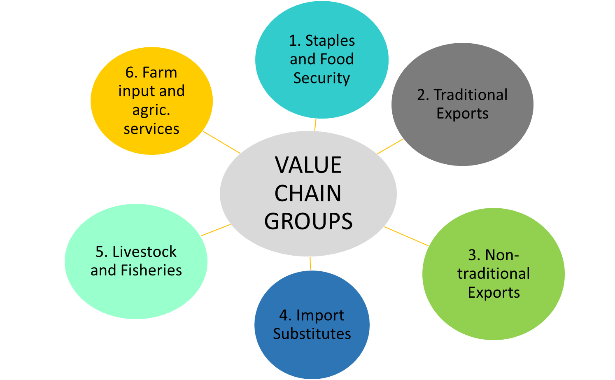
5TH AAPC SESSIONS

Slide 4
5TH AAPC SESSIONS
Thematic
Sessions
1. Agriculture Transformation
3. Youth in agriculture
5. Progress in Policy reforms
4. Nutrition

Slide 5
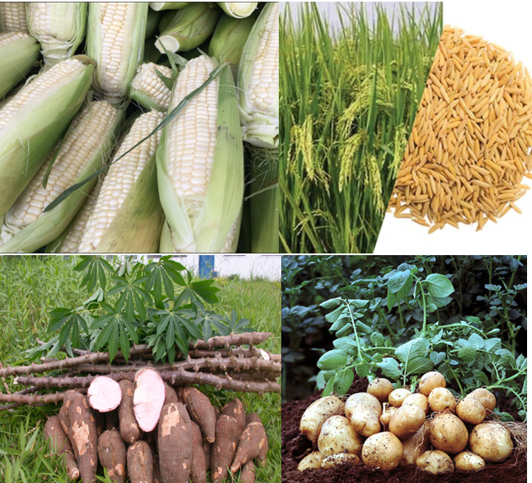
Staples AND FOOD SECURITY

Slide 6





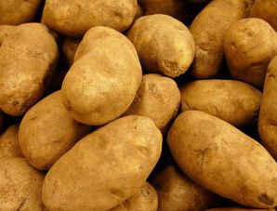
SUMMARY STATISTICS 2016/17-2017/18
Maize
Farmers: 7.4 mil (88%)
Area Cultivated: 3.5 mil ha
Yield: 1.7 tons/ha
Production: 6.3 mil tons
Domestic Requirement: 5 mil tons
Cassava
Farmers: 1.9 mil (23%)
Area Cultivated: 0.9 mil ha
Yield: 2.8 tons/ha
Production: 2.8 mil tons
Domestic Requirement: 2.3 mil tons
Bulrush Millet
Farmers: 0.3 mil (4%)
Area Cultivated: 0.2 mil ha
Yield: 1.2 tons/ha
Production: 0.2 mil tons
Domestic Requirement: NA
Rice
Farmers: 1.6 mil (19%)
Area Cultivated: 1.1 Mil ha
Yield: 2 tons/ha
Production: 2.2 mil tons
Domestic Requirement: 0.9 mil tons
Sorghum
Farmers: 1.1 mil (13%)
Area Cultivated: 0.6 mil ha
Yield: 1.2 tons/ha
Production: 0.7 mil tons
Domestic Requirement: NA
Round Potatoes
Farmers: 0.2 mil (2.4%)
Area Cultivated: 0.1 mil ha
Yield: 3 tons/ha
Production: 0.4 mil tons
Domestic Requirement: NA
Source: NBS- Annual Agriculture Sample Survey 2016/17 MoA Food Security Department 2017/18

Slide 7
POLICY ISSUES
How can Tanzania participate in intra-regional food trade without risking food insecurity?
What are alternative food security policy options beyond export bans?
How to manage public stocks such as NFRA without distorting the market?
Despite being food self-sufficient, Tanzania has one of the highest incidences of malnutrition: How could Tanzania achieve nutrition-sensitive agriculture?

Slide 8
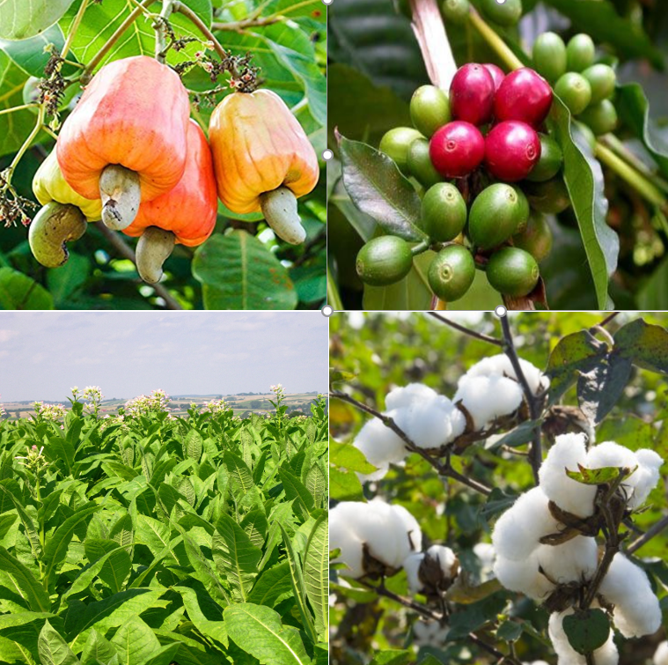
Traditional exports crops

Slide 9



Summary statistics
CASHEW
Exports USD 575.6M
Farmers 666,800
Production 313,800 Tons
TOBACCO
Exports USD 228.3M
Farmers 142,000
Production 83,000 Tons
COFFEE
Exports USD 128.2M
Farmers 183,000
Production 54,000 Tons
COTTON
Exports USD 66.5 M
Farmers 500,000
Production 215,000 Tons
TEA
Exports USD 46.1M
Farmers 50,000
Production 33,000 Tons
SISAL
Exports USD 33.2 M
Farmers 16,500
Production 38,000 Tons
Sources: 1.Production data NBS- Annual Agriculture Sample Survey 2016/17, 2. Data on number of farmers-NBS Annual Agriculture Sample Survey 2016/17, 3.Data on export earning -BOT

Slide 10

Key policy issues
Traditional export value chain has the following policy issues:
  Indicative pricing and the perceived risk of market distortion
  Market regulation including operation of actions
  How to operationalize commodity exchange
  How to incentivize domestic production taking into consideration policy tools such as export levy
  Re-exports of Tanzania’s cash crop to intermediate countries
  Export of raw commodities

Slide 11
NON-TRADITIONAL EXPORT CROPS

Slide 12





Summary statistics
HORTICULTURE
Exports: USD 156 M
Farmers: 450,000
Production: 6, 541,800 Tons
FRUITS
Production: 5,243,300 Tons
VEGETABLES
Production: 1,298,300 Tons
COMMON BEANS
Farmers: 1,945,200
Production: 1,096,900 Tons
COWPEAS
Farmers: 412,700
Production: 121,000 Tons
PULSES
Exports: USD 0.145 M
Farmers: 3,120,900
Production: 1,823,000 Tons
GREEN PEA
Farmers:
Production: 116,500 Tons
PIGEON PEA
Farmers: 727,400
Production: 101,400 Tons
SOYA BEANS
Production: 5,700 Tons
Sources: 1.Production data NBS- Annual Agriculture Sample Survey 2016/17 and MoA , Food Security Report 2018 2. Data on number of farmers-NBS Annual Agriculture Sample Survey 2016/17|3.Data on export earning –BOT 4. Soya beans production- FAOSTAT 2017 3. Icons- Project noun and google images

Slide 13




Key policy issues
1) Multiple taxation and overregulation within the subsector
horticulture (subjected to nearly 45 different taxes, levies and fees and the businesses are regulated by over 15 bodies)¹
2) Delay and costly registration of pesticides, seed and fertilizer
3) Trade policy for non-traditional exports, especially dry beans is characterized by ad hoc restrictions on exports and unpredictable import regulation.
4) Challenges to land access

Slide 14
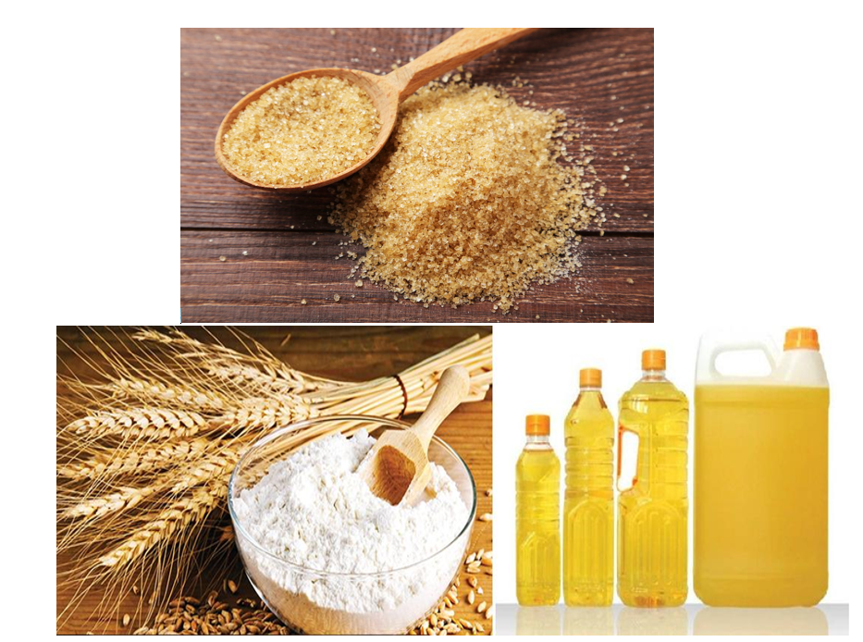
IMPORT SUBSTITUTION COMMODITIES

Slide 15



SUMMARY STATISTICS
Wheat
Edible oils
Sugar
Production: 94,073 ton
Demand: 1 mil ton
Import: 900,000 ton
Import bill: US$225 M
Production: 216,000 ton
Demand: 600,000 ton
Import: 420,000 ton
Import bill: US$270 M
Production: 300,000 ton
Demand: 630,000 ton
Import: 330,000 ton
Import bill: US$132 M
Source: MoA crop production data 2017, USDA gain report 2018, Dalberg sunflower policy brief 2018, SBT 2018, Rabobank 2017

Slide 16

Key policy issues
What policy would promote domestic industry without restricting trade?
What is the best policy option(s) to incentivize domestic import substitution industry (export levy, licensing, processing zone, etc.)?
How could the country mitigate dumping of subsidized exports goods from the country of origin?
What is the best policy option for managing imports with policy tools such as import tariffs and trade restrictions?

Slide 17
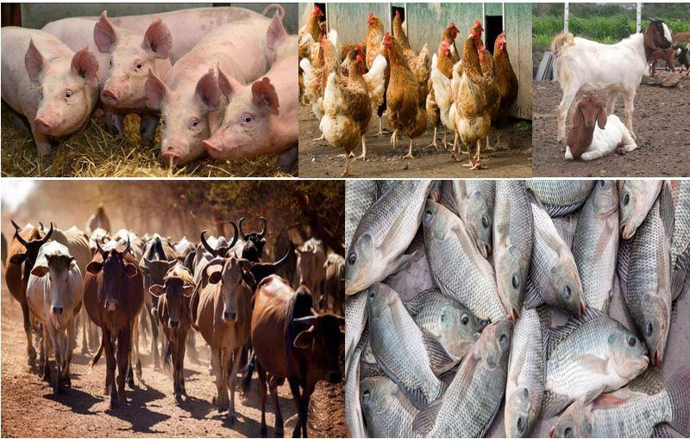
LIVESTOCK AND FISHERIES

Slide 18





Summary statistics (animal products)
Production: 679,992 ton
Per capita consumption: 15kg
Export: 2,608.9 ton
Export earnings: US$5.68 M
Import: 1,401.96 ton
Import bill: US$4.37 M
Production: 3.16bil
Per capita consumption: 106
Production: 363,395 ton
Per capita consumption: 8.6kg
Export: 36,063.2 ton
Export earnings: US$182.43 M
Import: 22,961.67 ton
Import bill: US$25.07 M
Production: 7.6 mil pieces
Export: 1.83 M pieces
Export earnings: US$4.09 M
Import bill (leather products): US$57.2 M
Production: 2.4bil lt
Per capita consumption: 47lt
Import: 9,286.3 ton
Import bill: US$13.77 M
Source: MLF,2018, NBS

Slide 19




KEY POLICY ISSUES
Policy options to manage imports of livestock and livestock products (dairy, poultry, etc.)
How to enhance the competitiveness of import substitutes
Managing feed quality and cost/How to develop the feed industry without competition with human consumption
Managing conflicts between farmers and livestock keepers

Slide 20

FARM INPUTS AND AG. SERVICES

Slide 21

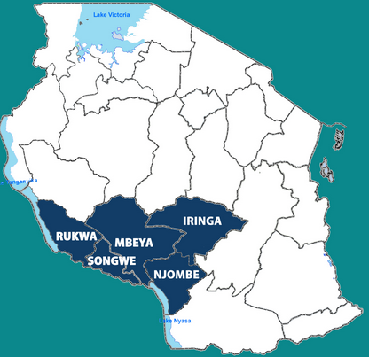

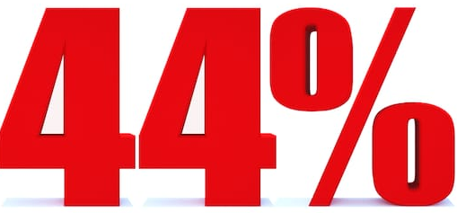

OVERVIEW
Imports
Tanzania imports more than 90% of its inorganic fertilizer (Urea, DAP and NPK)
Major importing countries: Saudi Arabia, Russia, Morocco
60% of all the all fertilizer is used in the Southern Highlands regions
(TFRA, 2018)
Import Bill: USD 155.1 mil in the year ending October 2018 (BoT, 2018)
Utilization
Increase in fertilizer utilization between 2015/16 and 2017/18
(TFRA, 2018)
BPS Savings
TZS 20.5 billion from economies of scale in 2017/18
(TFRA, 2018)

Slide 22
IRRIGATION AND USE OF IMPROVED SEED
Irrigation
Planted Area with/Without Improved Seed
Number of farmers applying irrigation: 400,000
NBS: Annual agricultural Sample Survey 2016/17
NBS: National Sample Census Of Agriculture, Small Holder Agriculture, 2007/08

Slide 23

POLICY ISSUES
Regulatory reforms to reduce the timeline and cost of registration for seed/breed variety, pesticides/veterinary medicine, and fertilizer/livestock feed
Extension policy to ensure farmers access to knowledge for appropriate agronomy and livestock husbandry
Regulatory reforms to enhance competition and efficiency in farm input value chain
Alternative policy options to enhance access to farm input without dependency on input subsidy

Slide 24
THANK YOU

